Slide 1
ANLP
NLP in Finance
Gaurav Pathak
11/15/2018

Slide 2
Introduction

Slide 3
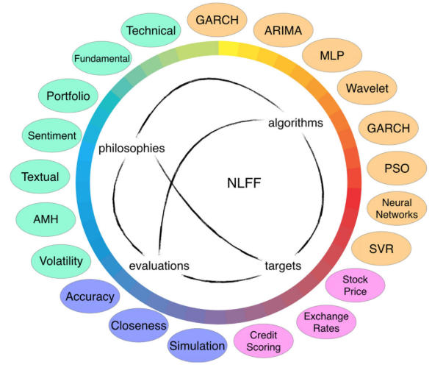
Introduction
What is finance?
”The study of how money is managed and the actual process of acquiring needed funds. It encompasses the oversight, creation and study of money, banking, credit, investments, assets and liabilities that make up financial systems.” -Investopedia
Natural Language Based Financial Forecasting (NLFF) Xing et. al.

Slide 4
Today’s topics
Background
Efficient Market Hypothesis
What is Alpha?
Market Basics
NLP for Alpha generation
Twitter sentiment Analysis
Breaking news for stock prices.
FOMC minutes classification
Other Applications
“Back/middle office” functions
NLP-like techniques
Parsing

Slide 5
The Efficient Market Hypothesis
The efficient market hypothesis (EMH) maintains that market prices fully reflect all available information. Developed independently by Paul A. Samuelson and Eugene F. Fama in the 1960s, this idea has been applied extensively to theoretical models and empirical studies of financial securities prices, generating considerable controversy as well as fundamental insights into the price-discovery process.
For publicly traded assets/instruments, the various levels of EMH say the following:
Weak: Prices reflect all publicly available information
Semi-Strong: Prices reflect all publicly available information and react instantly to new information
Strong: Prices reflect all information, including hidden “insider” information.
“It should be impossible to beat the market consistently on a risk adjusted basis”

Slide 6
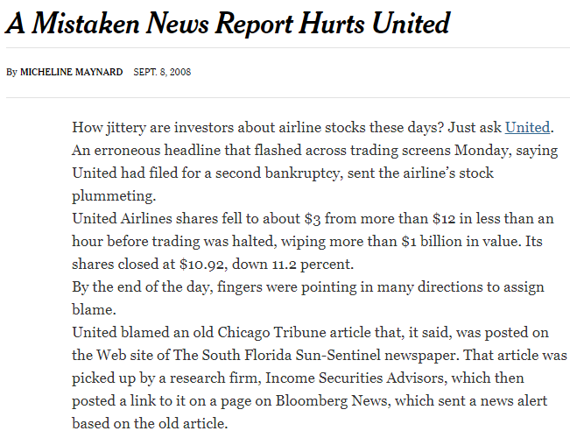
Effect of “new” information on an asset price
United Airlines’ stock fell to about $3 from $12 in less than an hour
Culprit was the publication of an old news report saying united was filing for bankruptcy

Slide 7
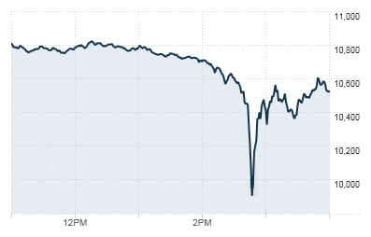
Markets are very Reactive: The 2010 Flash Crash
A trillion dollar market crash that lasted for approximately 36 minutes
Other instances as well:
Most recently Monday, August 24, 2015
1000 point drop in the 1st 5 minutes of trading
Most trading falls are recovered within a few minutes
The DJIA on May 6, 2010 (11:00 AM - 4:00 PM EST)
Notes:
Why did it happen?
1000 point DOW drop

Slide 8
Importance of good tech:
KCG holdings crash
August 1, 2012
A repurposed flag caused wrong code to be executed, leading to millions of incorrect orders being placed in the market
For example, shares of Wizzard Software Corporation went from $3.50 to $14.76 - Wikipedia
The firm lost $440 million in around 45 minutes.

Slide 9
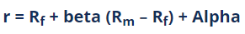
What is Alpha?
R is the portfolio return
Rf is the risk free rate of return
Beta is the risk/correlation of the portfolio to a benchmark
Rm represents market return
GIven the EMH from before, unless you have better information, it should be impossible to get “Alpha”, your return should depend on your beta and the market return.

Slide 10
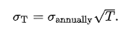
Volatility, Risk
The annualized volatility of an instrument is the standard deviation of an instrument’s yearly logarithmic returns. For T years, the volatility is given by the equation below
This is generally taken as a measure of risk.
Most of the time these measures are ex-ante/ historical volatility.
Ignores tail risk, changing nature of volatility especially in events like 2008

Slide 11
Signals
“Functions conveying ‘information about the behavior or attributes of some phenomena’”-Wikipedia
Stems from the work of Claude shannon on information content, entropy, capacity of a communication channel etc.
Financial signals are ones that give the best estimation of the movement of the prices of various assets
Much of the work in quantitative investing revolves around finding these “signals”
Signals are very well kept secrets.
Firms like Jim Simons’ Renaissance Technologies are one of the firms that use financial signals to trade.
When finding signals there is a whole host of issues like spurious correlations, crowding out etc.

Slide 12
Trading Venues
Assets can be traded in many venues
Exchanges
Lit Exchanges
Dark Pools
Over the Counter (OTC)
Assets traded in venues are generally considered “liquid”
Some assets are thinly traded, e.g. very small companies, off the run treasuries etc. and would be “illiquid”, i.e. the last traded price is not representative of fair value
There are illiquid assets such as private equity and venture capital. These aren’t traded on an exchange. Generally a private equity shop or venture capitalist will list their holdings on an exchange via IPO
Market Makers, Institutional Investors

Slide 13
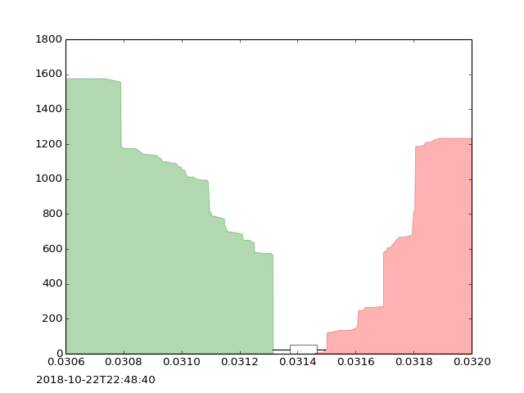
The order book
Limit order book
Bids on one side
Offers on the other
When someone “crosses the spread”, a trade happens
The spread can be low for items whose fair value is clear, high during times of uncertainty (Market Making)
If you want to buy instantly, you pay the ask/offer, to sell instantly, you get the bid
https://pro.coinbase.com/trade/BTC-USDC

Slide 14

Alpha generation
How can we use NLP to find “new” information

Slide 15
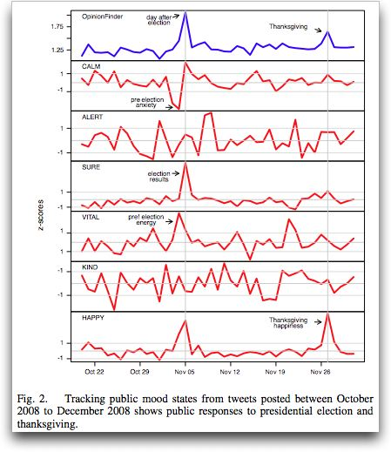
Twitter mood predicts the stock market
Johan Bollen, Huina Mao, Xiao-Jun Zeng (2010)
Journal of Computational Science

Slide 16
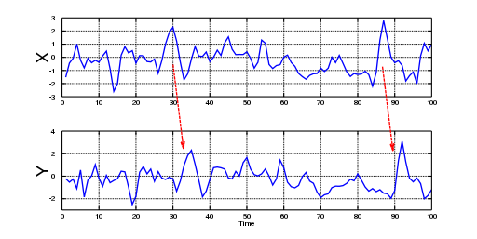
Background: Granger Causality
“Is one time series useful in predicting another time series”
A time series X is said to Granger cause Y if it can be show, usually through a series of t-tests and F-tests on lagged value of X (and with lagged values of Y also included), that those X values provide statistically significant information about the future values of Y. -Wikipedia
The usage of past values of X and Y should be better than using the past values of Y alone

Slide 17
Introduction
Emotions can affect individual behavior and decision-making.
Can this affect societies in large and in effect, economic indicators?
Investigates whether mood states derived from large scale Twitter feeds are correlated to the value of the Dow Jones Industrial Average
Granger Causality Analysis and a Self-Organizing Fuzzy neural network are used to investigate the hypothesis that public mood states are predictive of changes in DJIA closing values

Slide 18
Data Collection
Data Description
Collection of Public Tweets from February 28 to December 19th 2008
9m tweets, 2.7m users
Each tweet had a tweet identifier, date-time of submission and the 140 character content itself.
Date Processing
Removal of stop words and punctuation
Restriction of tweets to mood related ones.
Matching on I feel, I am feeling, I’m feeling, etc.
Spam removal: regex match on http: or www.
Group the tweets by submission date

Slide 19
Mood extraction
OpinionFinder
Given a sentence, returns the magnitude of how negative/positive the sentence is.
Creates a time series of whether sentiment is positive or negative, degree of positivity/negativity
Google Profile of Mood States (GPOMS)
6 indicators of mood
Creates a time series on 6 dimensions

Slide 20
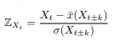
GPOMS and OpinionFinder Normalization
Z scores on the basis of local mean and standard deviation with a sliding window of k days before and after the particular date
This allows comparison of OF and GPOMS scores
6 different GPOMS mood dimensions:
Calm, Alert, Sure, VItal, Kind and Happy
PoMS, an original 72 terms expanded to a lexicon of 964 associated terms
Usage of co-occurrences in 2.5 billion 4 and 5 grams computed by Google in 2006
Each tweet that has an n-gram is thus matched backed to its original mood dimension

Slide 21
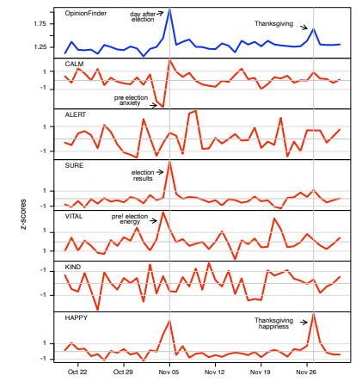
Validation
Z-scores for OF and GPOMS metrics
Important dates are the presidential election and thanksgiving

Slide 22
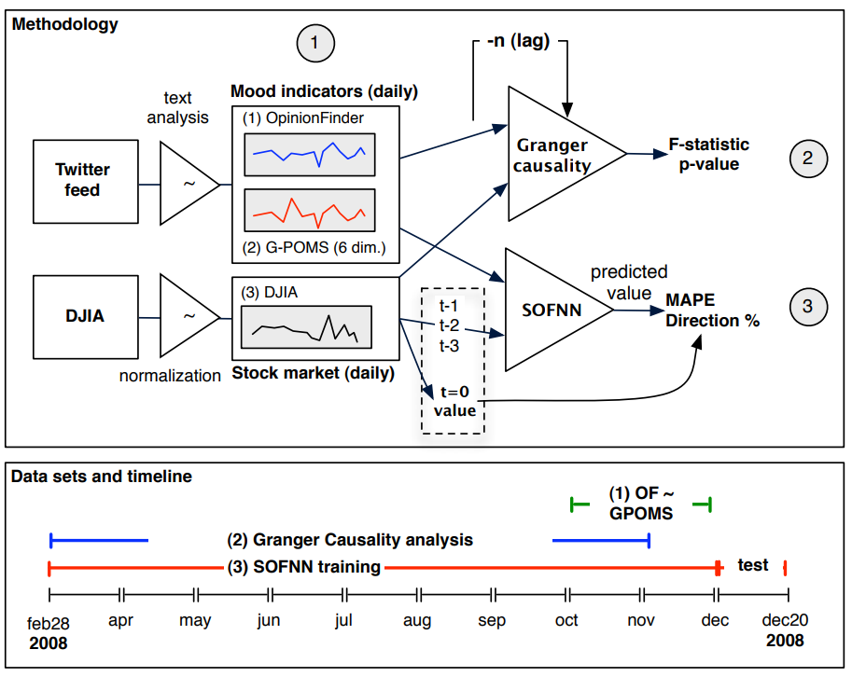
Methods/System
Phases of the methodology and datasets used.
Notes:
Diagram outlining 3 phases of methodology and corresponding data sets: (1) creation and validation of OpinionFinder and GPOMS public mood time series from October 2008 to December 2008 (Presidential Election and Thanksgiving), (2) use of Granger causality analysis to determine correlation between DJIA, OpinionFinder and GPOMS public mood from August 2008 to December 2008, and (3) training of a Self-Organizing Fuzzy Neural Network to predict DJIA values on the basis of various combinations of past DJIA values and OF and GPOMS public mood data from March 2008 to December 2008.

Slide 23
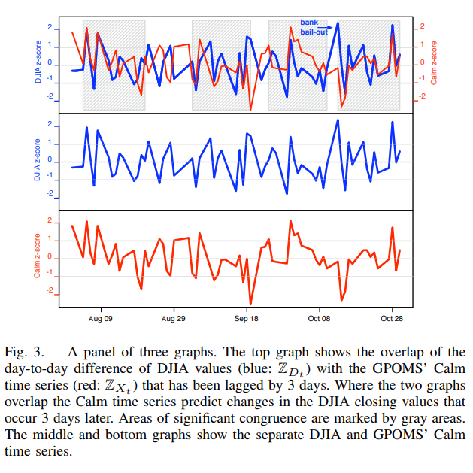
Results

Slide 24
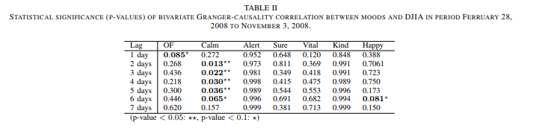
Results

Slide 25
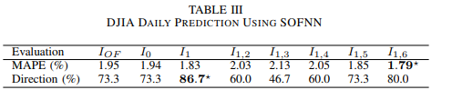
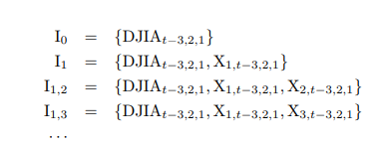
Self Organizing Fuzzy Neural Network

Slide 26
Conclusion
The authors find an accuracy of 87.6% in predicting the daily up and down changes in the closing values of the DJIA and a reduction of the Mean Average Percentage Error by more than 6%.
They observe that Calm mood has the highest Granger causality relation with DJIA for lags ranging from 2 to 6 days (p-values < 0.05). The other four mood dimensions of GPOMS do not have significant causal relations with changes in the stock market, and neither does the OpinionFinder time series.

Slide 27
Questions
Baselines: Predicting DJIA direction is not equivalent to predicting flips of a coin
GPOMS: No extensive testing of the GPOMS methodology other than the observation before and after the presidential election/thanksgiving
Z-scores: The scores take a time windows before and after a particular date. So, is it encapsulating mood after the stock market has changed rather than just before?

Slide 28
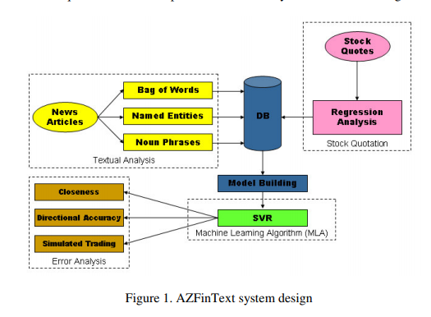
Textual Analysis of Stock Market Prediction Using Breaking Financial News: The AZFin Text system
Schumaker and Chen (2009),
ACM transactions on information Systems

Slide 29
Introduction
Using breaking news to predict stock price movements
Bag of Words
Noun Phrases
Named entities
How effective is the prediction of stock price values using textual financial news articles
Which combination of textual analysis techniques is most valuable?

Slide 30
Data
9211 Financial News Articles
10,259,042 stock quotes
S&P 500 stocks
Oct 26 to Nov 28, 2005
New articles gathered from Yahoo Finance
Arizona text Extractor (AzTek) for word level tagging, noun phrasing, entity extraction

Slide 31
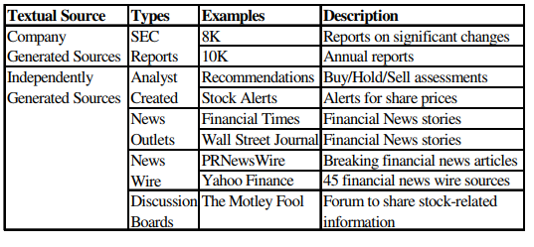
Example Data Sources

Slide 32
Article Representation Tactics
Bag of Words
Stop word removal
Noun phrasing
POS tagger and syntactic rules to identify noun phrases
Named entity recognition
Noun phrases plus categories
MUC-7 framework
Date, location, Money, Organization, Percentage, Person, time

Slide 33
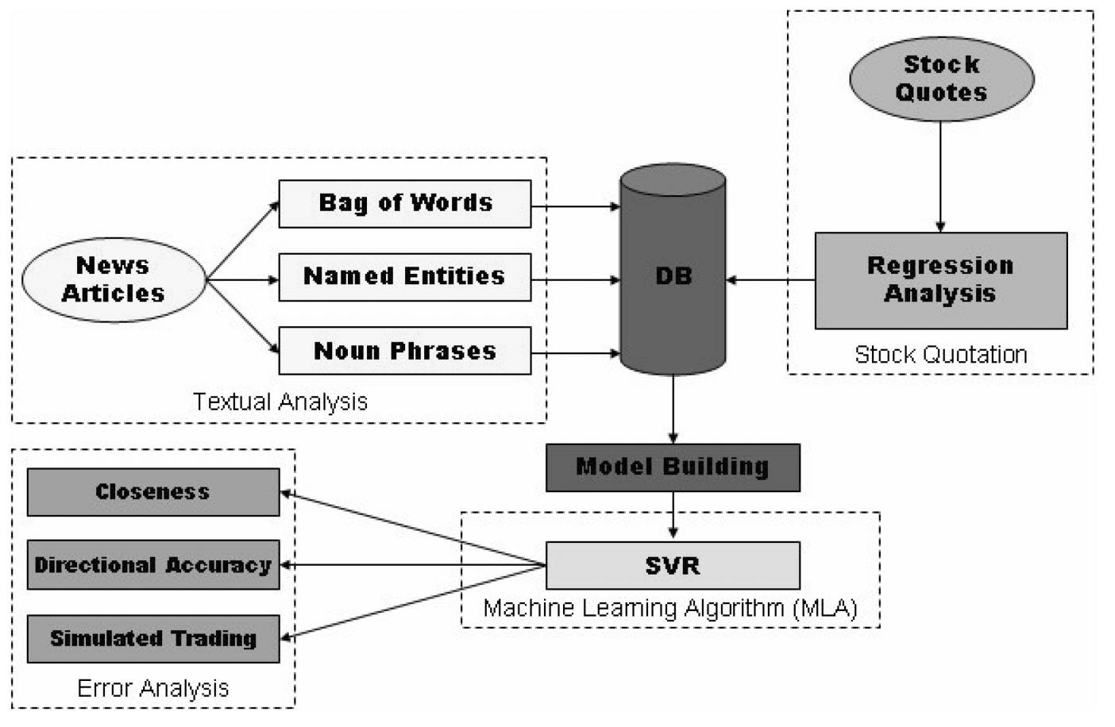
Method
Trying to estimate a discrete stock price twenty minutes after a news article was released
Notes:
Bag of words: Stop words are removed
Noun Phrasing: POS tagger plus surrounding context
Named Entities: Noun phrases plus pre-determined entities

Slide 34
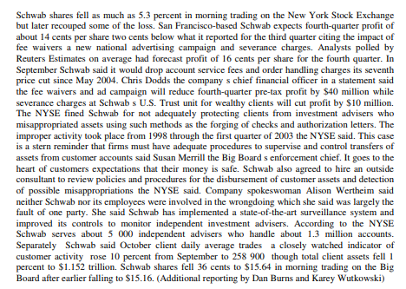
News Article

Slide 35
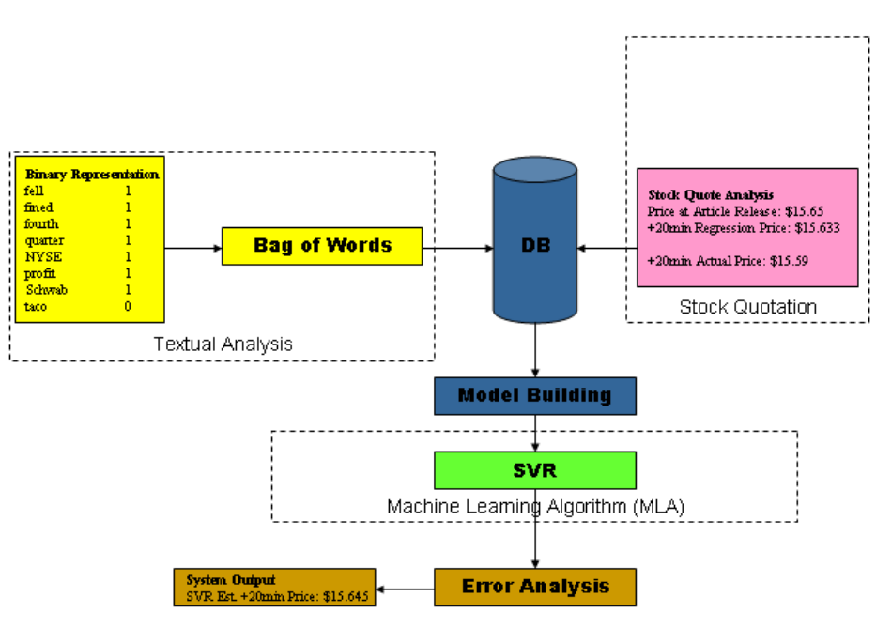

Slide 36
Simulated Trading Engine Rules
Capital of $1000 per trade
Buy the Stock if the price is 1% higher/lower than the release time
Position are closed after 20 minutes
Assumes zero transaction costs

Slide 37
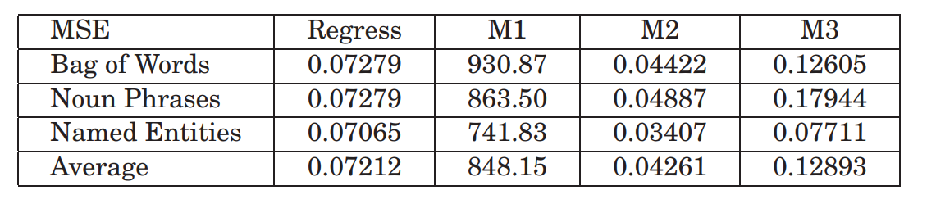
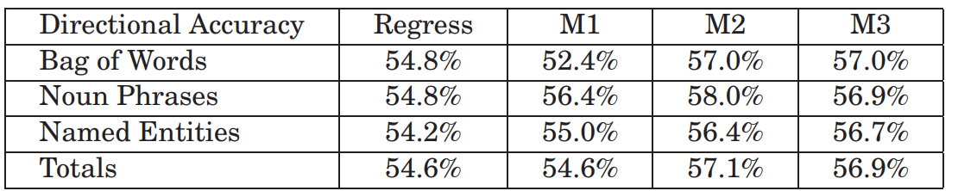
Results
Closeness
Directional Accuracy
Notes:
Model M1, uses only extracted article terms for its prediction. While no baseline stock price exists within this model, we chose it because of its frequent usage in prior studies on directional classification of stock prices. Model M2, uses extracted article terms and the stock price at the time the article was released. We feel that given a baseline of stock price that this 15 model will fare better. Model M3, uses extracted terms and a regressed estimate of the +20 minute stock price. This model may lead to better predictive results should the article terms have no impact on the movement of the stock price.

Slide 38
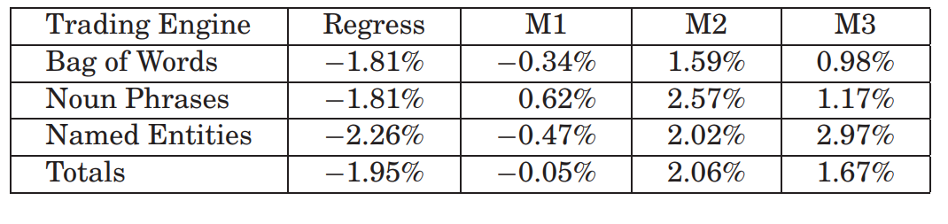
Trading engine results

Slide 39
Critique
Mostly on the Trading Engine Methodology
Usage of “price” rather and bid-ask spreads
“Trading costs are zero in large volumes”
Usage of data to predict magnitude/direction in the low single percentages, one cannot ignore bid-ask spreads, especially for illiquid securities
What does a 2% return from the simulated trading engine mean?
Baseline
Beta/correlation
CAPM results

Slide 40
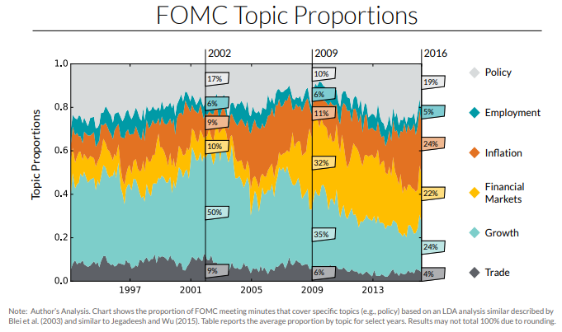
FOMC Minutes Analysis
Deciphering Fedspeak: The Information Content of FOMC Meetings, Jegadeesh and Wu, 2017, Working Paper
Two Sigma Street View

Slide 41
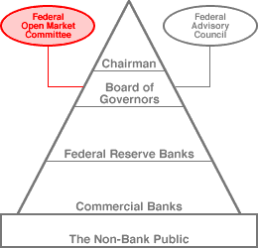
What is the FOMC?
“The Federal Open Market Committee (FOMC) is the monetary policymaking body of the Federal Reserve System. “ -FOMC website
Why is it important?
It sets the monetary policy objective
Monetary policy is used as a tool to slow down a heated economy/ bring up an economy in a recession
Actions of the FOMC has an immediate/material impact on the markets, especially the interest rate markets
When does the FOMC release information?
At 2pm on the final day of each Federal Open market Committee meeting

Slide 42
Methodology
Topics Extracted by LDA:
Policy Stance
Inflation
Financial Market
Employment
Economic Growth
Foreign Trade
Consumption
Production
Investment
Reaction of Stock and Bond Markets to proportion of discussion devoted to each topic
SPY ETF as indicator for stocks
Eurodollar futures (LIBOR) for bond markets
Tone of each topic also considered
Bag of words method used
Harvard IV-4 Psychological Dictionary used
Higher tonal score represents a positive/easing stance
Event window: A 15 minute event window around the 2pm release is considered

Slide 43
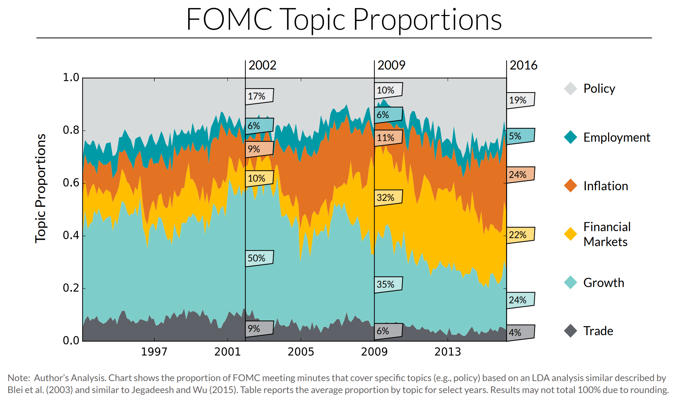

Slide 44
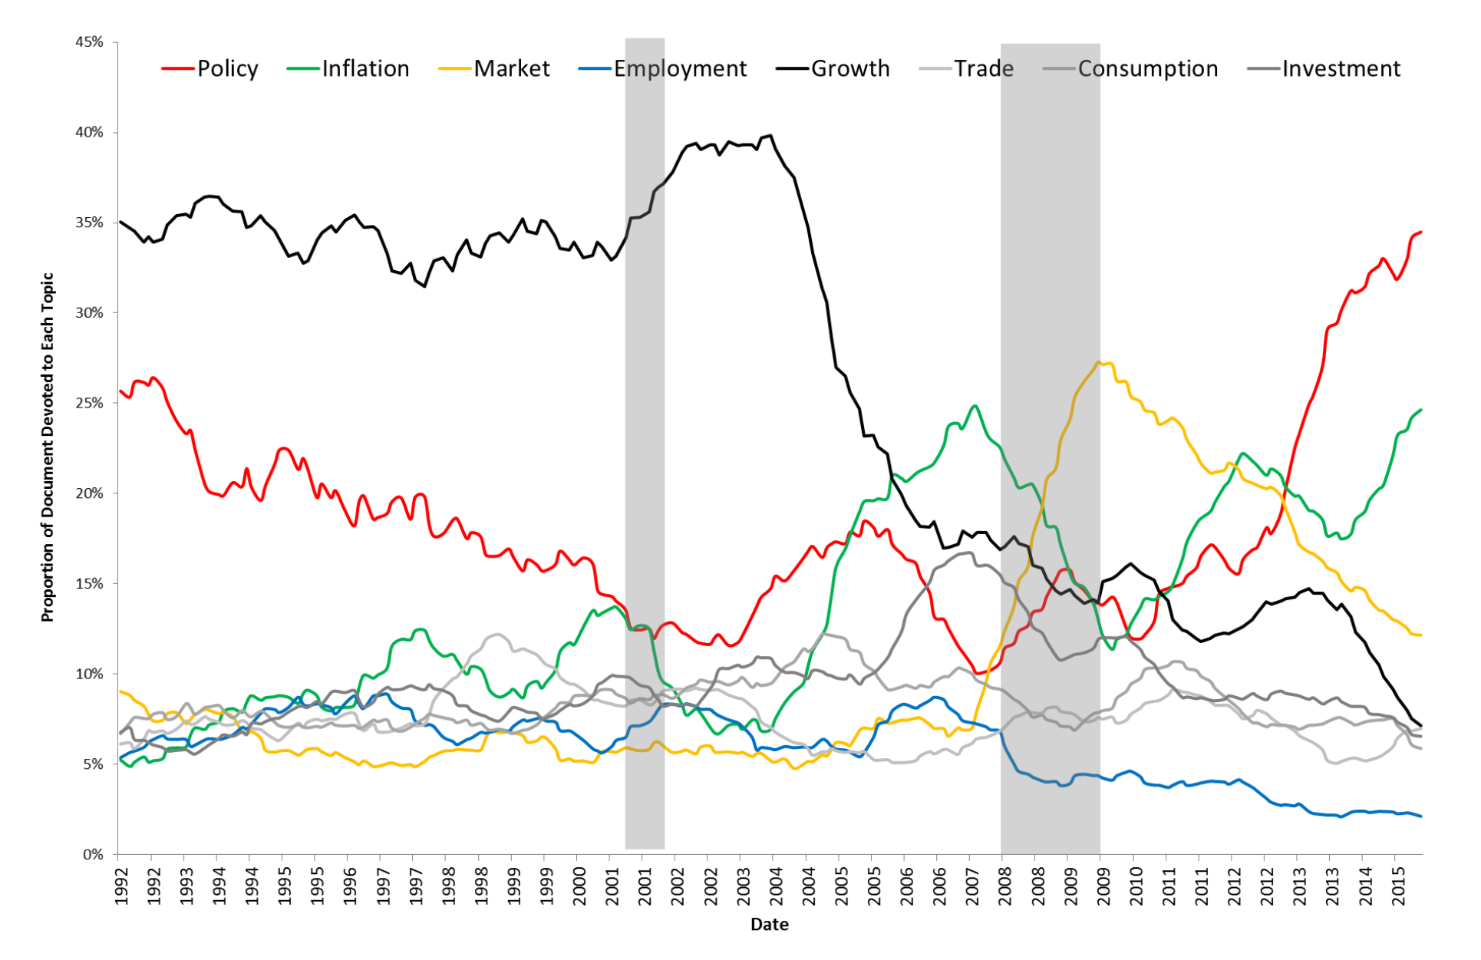
Results

Slide 45
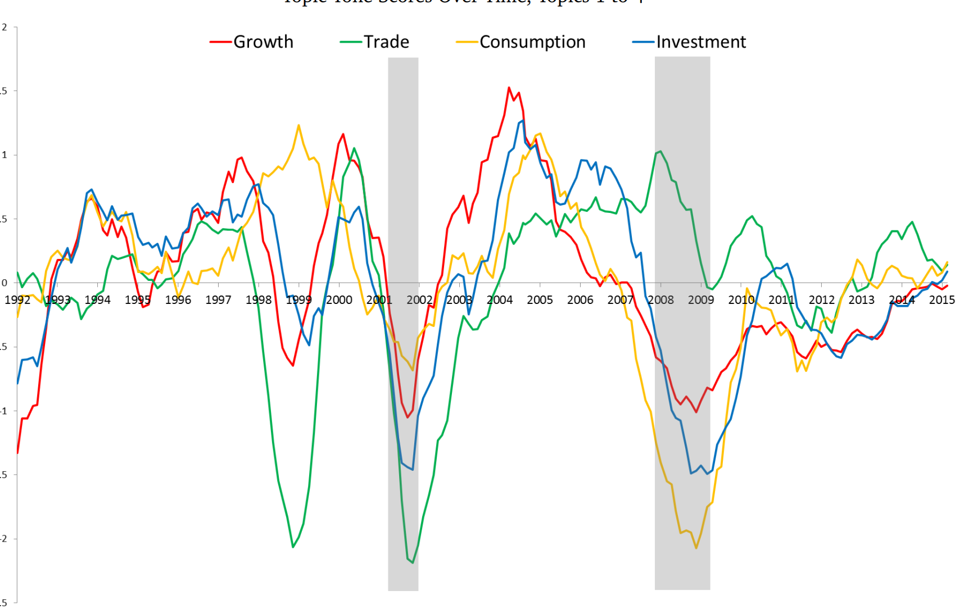
Results- Proportion of time dedicated to each topic

Slide 46
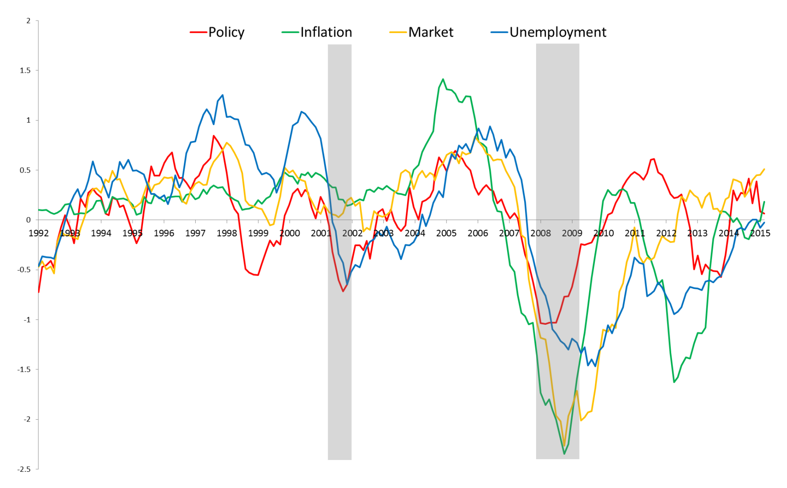
Results - Tone of some topics

Slide 47
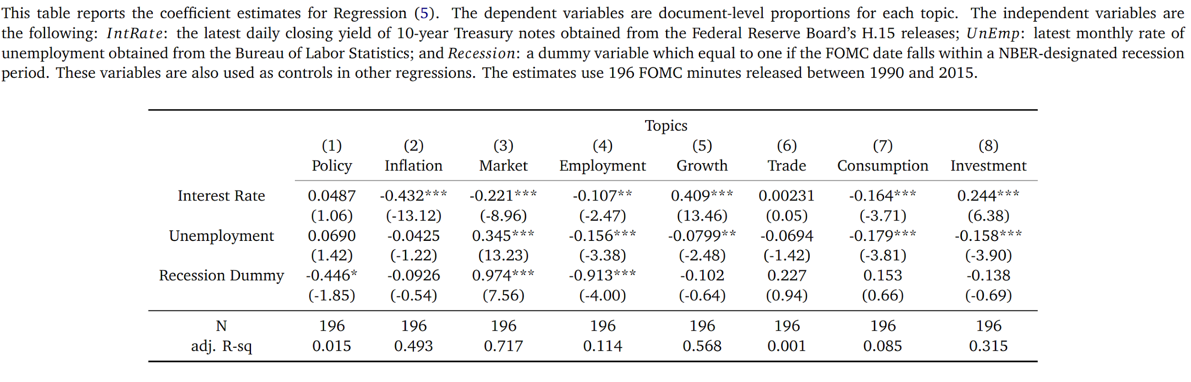
Regression results

Slide 48
Conclusions
Significant Variation in the Proportion and tones of topics
Negative tone during recessions and when unemployment is high
Directional Stances:
Policy Stance is positive for SPY but negative for LIBOR
Makes intuitive sense, easing policy helps stocks hurts bond prices

Slide 49
The importance of Speed
How fast is new information reflected in prices

Slide 50
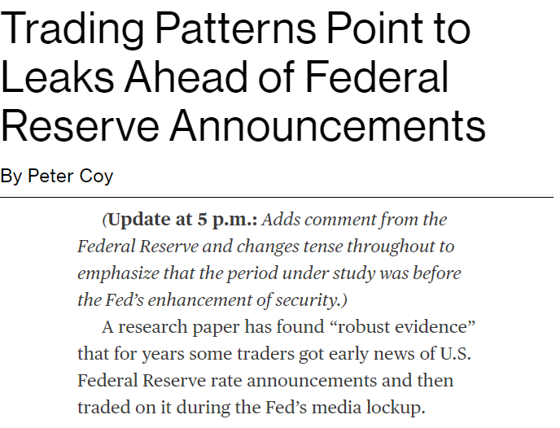
The importance of Information
2013 FOMC taper/no taper decision
Release of information using atomic clocks at 2pm
Trading timestamps not consistent with speed of light/time for information to reach Chicago from NY/Washington
Should markets be continuous? Is a call market better to prevent this speed race? (Wellman, 2013)

Slide 51
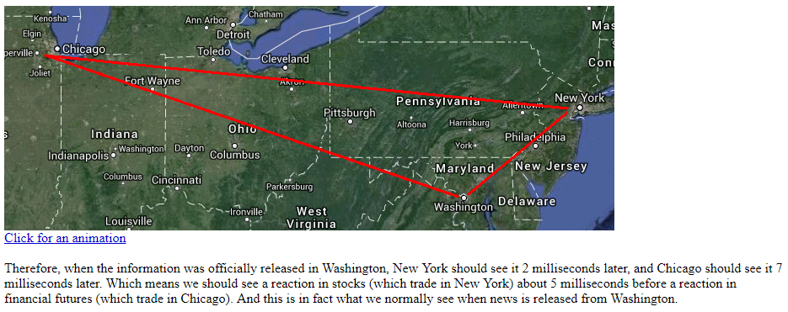
Source: Nanex Research

Slide 52
Other Applications

Slide 53
Where can NLP be used?
While the frequent focus of NLP on finance has been on alpha generation, the most immediate ways to generate value are actually in the management/middle office/back office roles
NLP is also very important in the regulatory side of things
Analysis of Investor Prospectuses
NLP for Anti Money Laundering/Fraud Detection

Slide 54
Sentence Classification for Investment Rules Detection
Youness Mansar and Sira Ferradans, Fortia Financial Solutions (2018) Association for computational Linguistics

Slide 55
Task Description
A regulatory change each 12 minutes per day in 2015 (Thomson Reuters)
Income dedicated to fines and settlements increased by 45x in the years around 2016
Current protocol for rule identification
Humans essentially highlight the pertinent rules in investment prospectuses
Paper Task:
Binary classification of sentences to indicate whether a sentence relates to an investment rule or not

Slide 56
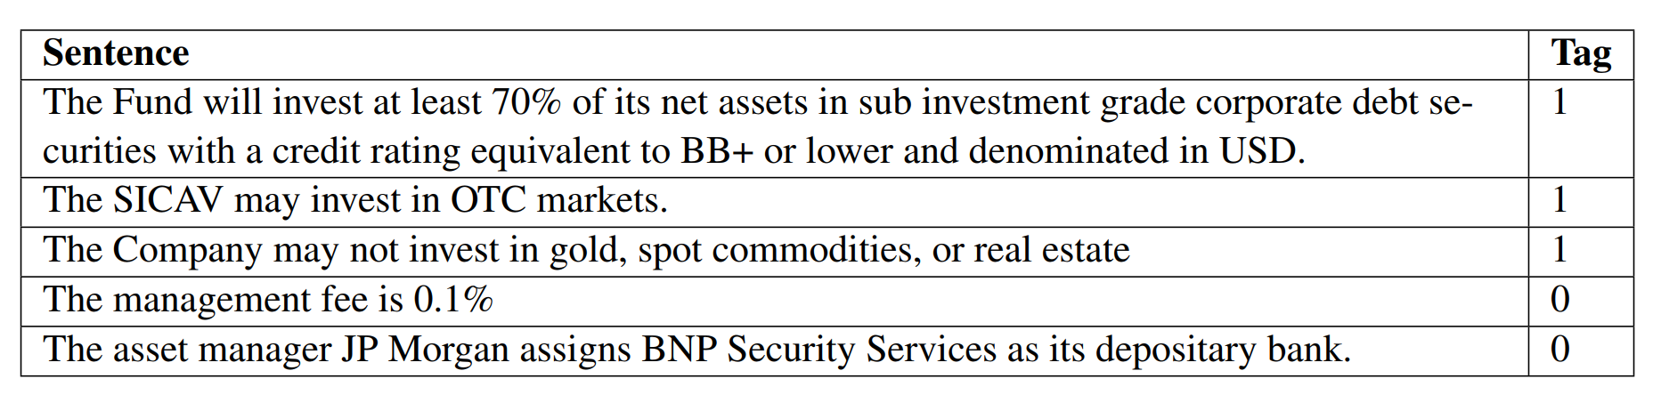
Data
Investment fund prospectuses were used as a data source.
Sentences were labelled as 1 or 0 based on whether they related to an investment rule/mandate or not
Word embeddings (GloVe) were pretrained using a corpus of the fund prospectuses and wikipedia pages

Slide 57
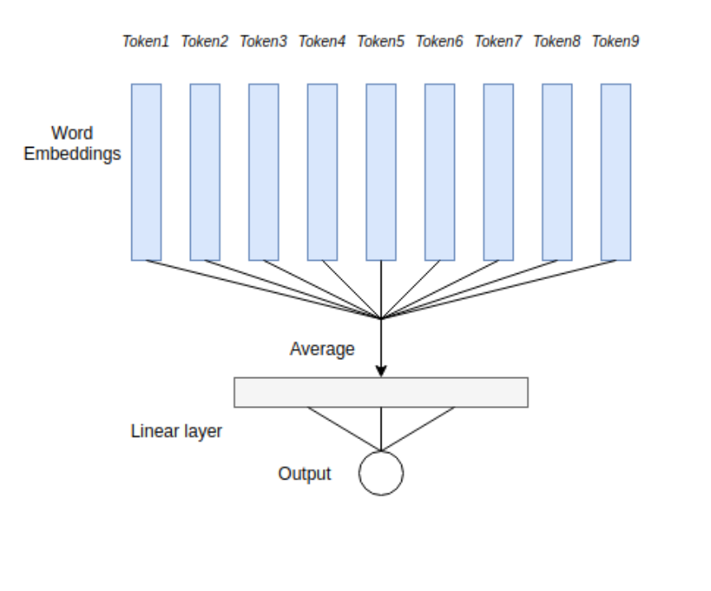
Methods - Linear network
Notes:
The Linear network model in this case is a logistic regression applied to an un-weighted average of dense word vectors. The advantage of this model is that it is simple while it also takes advantage of the unsupervised pre-training of the word embeddings. This also means that is very fast and computationally cheap compared to other models

Slide 58
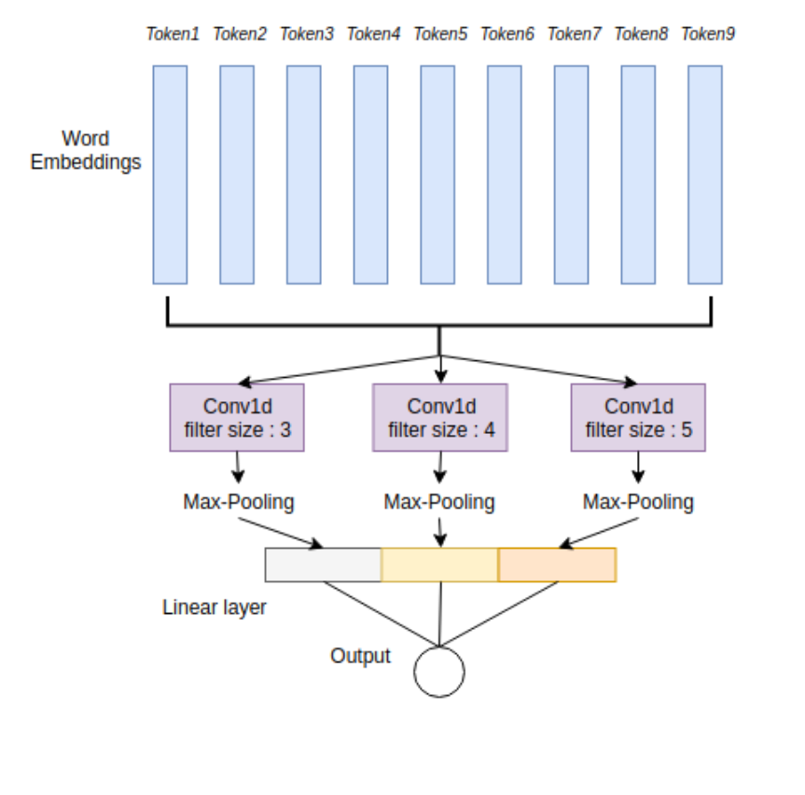
CNN
Notes:
Convolutional Layer : Three 1-dimensional convolution layers applied in parallel to the input embedding sequence. Each convolution layer uses a different filter size {3, 4, 5} and captures sentence information at different scales ( 3-gram, 4-gram, 5-gram ). The convolution filters learn translation-invariant representations which is useful for language because it allows for weight sharing between neurons and thus reduces significantly the number of weights compared to a fully connected layer. We use 100 filters for each layer and ReLu as a non-linearity for the convolution layers.
Max-pooling : Applies a max operation across the sequence and returns an output that has the same size as the number of filters in each convolution layer. • Concat Layer : Concatenates the output of each Max-pooling together. • Linear Layer : Applies a linear mapping from the concat layer to the output. • Sigmoid Activation : Maps the output to the [0,1] range.

Slide 59
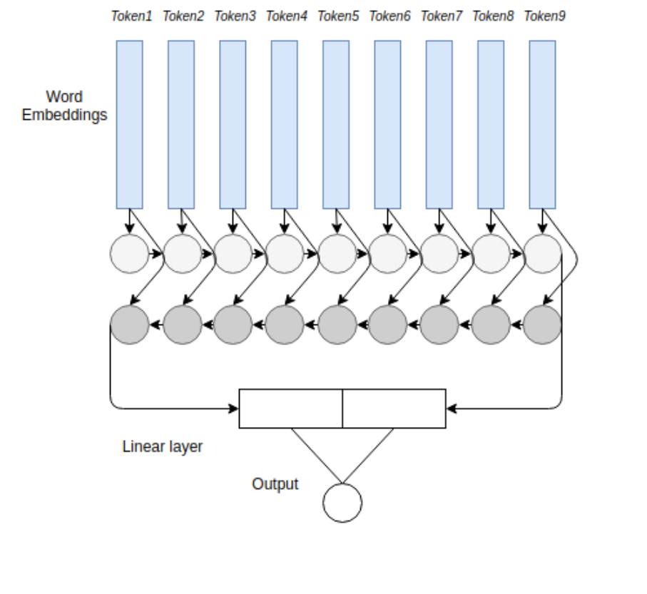
LSTM
Notes:
Forward LSTM : Sequential layer that is applied to the list of word embeddings from the 47 first token in the sentence to the last token and outputs the lstm cell state of the last token of the sentence. • Backward LSTM : Sequential layer that is applied to the list of word embeddings from the last token in the sentence to the first token and outputs the lstm cell state of the first token of the sentence. • Concat Layer : Concatenates the output of each LSTM layer. • Linear Layer : Applies a linear mapping from the concat layer to the output. • Sigmoid Activation : Maps the output to the [0,1] range.

Slide 60
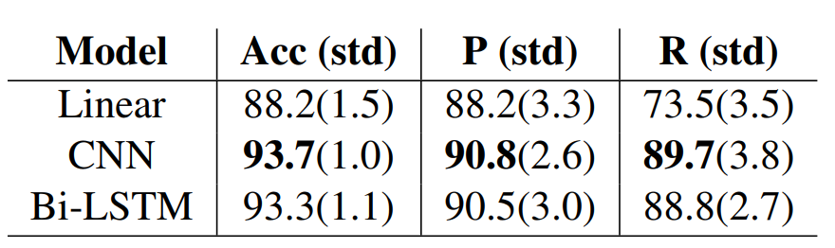
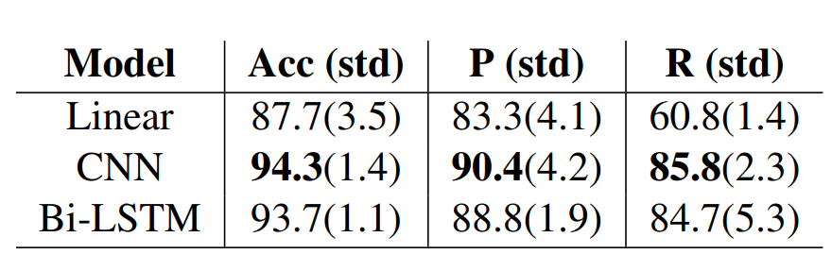
Results
French 10-fold cross validation
English 10-fold cross validation
Notes:
Accuracy, Precision, Recall

Slide 61
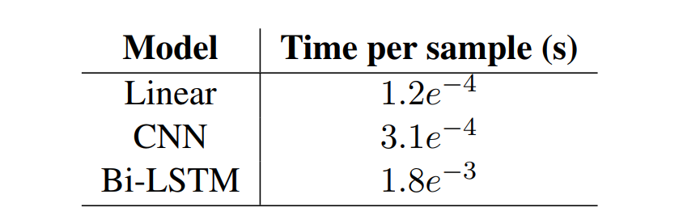
Results
Speed results

Slide 62
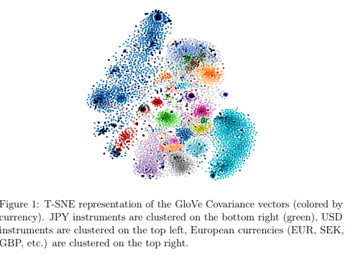
From Word to Financial Time Series Embedding
Maxim De Bruyn
Degroof Petercam Asset Management

Slide 63
Introduction
Just as we have pre-trained word vectors as the building blocks of various NLP tasks, can we do the same for financial time series?
What is the “lexicon” for financial time series?
The universe of investable assets
Such vectors can be used to visualize the investable universe by using methods such as t-SNE

Slide 64
Data
Holdings of the Vanguard Total World Stock ETF
7857 instruments
11 sectors, 24 industry groups, 37 currencies, 69 countries
Time series are constructed by using total returns
December 31 2016 to December 31 2017 used

Slide 65
Methodology
Methods Used
Skip Gram method
Glove Covariance/Glove Correlation
300 dimensional vectors trained
Visual examination of the vector representation using T-SNE
Notes:
The training objective of the GloVe algorithm is to learn word vectors so that their dot products equals the logarithm of the words’ probability of co-occurrence. The co-occurrence matrix measures the number of times the word j occurs in the context (defined by a context window length) of word i.
The GloVe algorithm can be transformed to fit time series embedding by switching the co-occurrence matrix with the correlation or covariance matrix.

Slide 66
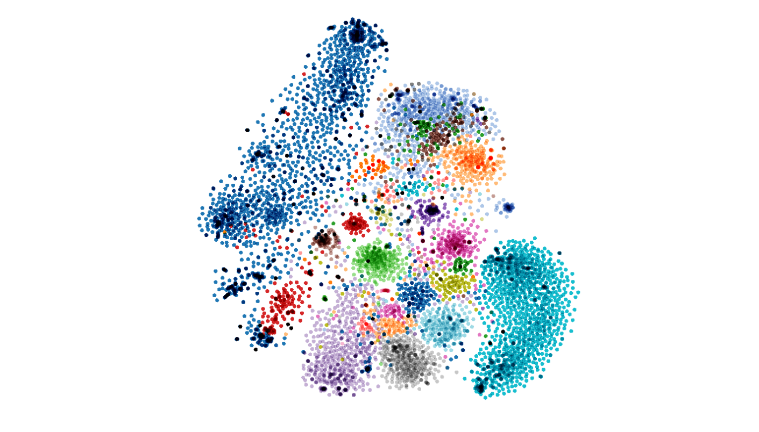
Results
T-SNE representation of GloVe Covariance vectors (colored by currency). JPY instruments are clustered on the bottom right (green), USD instruments are clustered on the top left, European currencies (EUR, SEK, GBP, etc.) are clustered on the top right.

Slide 67
https://projector.tensorflow.org/?config=https://raw.githubusercontent.com/maximedb/stock2vec/master/embeddings/config.json
Visualization of embeddings
Notes:
Tax-loss Harvesting

Slide 68
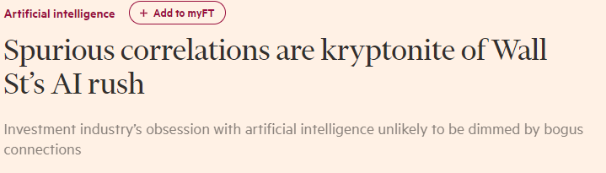
Noise
Imperfect data and some interesting results

Slide 69
Example
Politeness as a predictor of stock price
Chief executives that said “please”, “thank you” and “you’re welcome” more often enjoyed a better subsequent share price performance.
“butter production of Bangladesh is closely correlated to the returns of the US stock market” -Leinweber

Slide 70
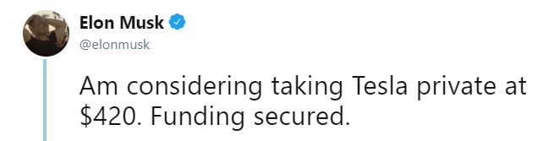
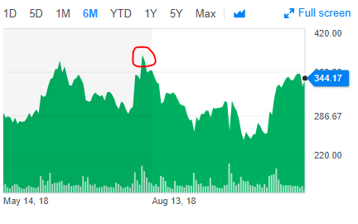
Pitfalls of Using Social Media Information
How do we check for reliability?
Examples:
TSLA (Hard for humans)
AP White House Tweet

Slide 71
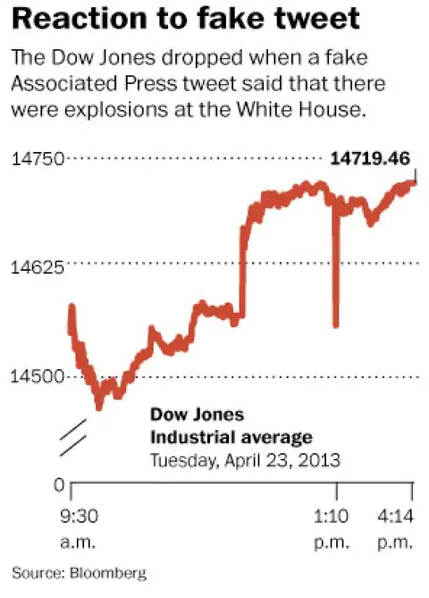
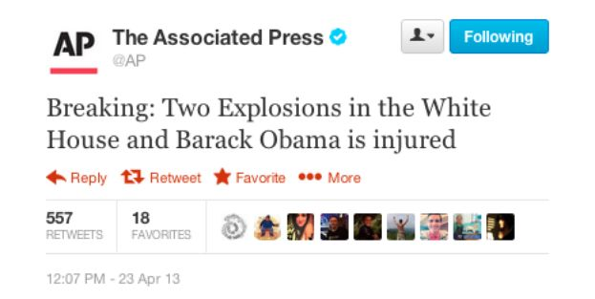

Slide 72
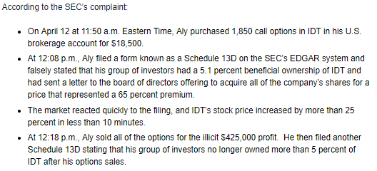
Company filings, Feed parsing
One of the common “NLP” techniques is simple parsing of data
Company filings are made at the SEC before/after significant company events
Hedge Funds, Traders etc. continuously monitor these filings and make trading decisions based on changes.
Example of manipulation

Slide 73
NLP for KYC/AML
Anti Money Laundering/ Terror Lists are an important consideration for financial Institutions
Need to determine if a new client, especially in Wealth management has terrorist links
Techniques
Named Entity Recognition
“Sentiment Analysis”
Use said sentiment scores to alert humans about potential problems

Slide 74
Discussion Questions
What other areas of finance can NLP be used for?
What the ethics of using NLP in finance, e.g. credit scoring
Weapons of Math Destruction -O’Neil
Given that we see the importance of speed in finance, what about the engineering aspects of building NLP systems?

Slide 75

Thanks!

